Slide 1

Work
Spotlight 8, module 3b

Slide 2

Wise thought

Slide 3

Remember!

Slide 4
Read and translate
author
traffic warden
vet
artist
lion tamer
operator
waiter
air traffic controller
architect
customs officer
graphic designer
accountant
cashier
computer programmer
pizza delivery boy
car salesman
sales assistant
bank teller

Slide 5
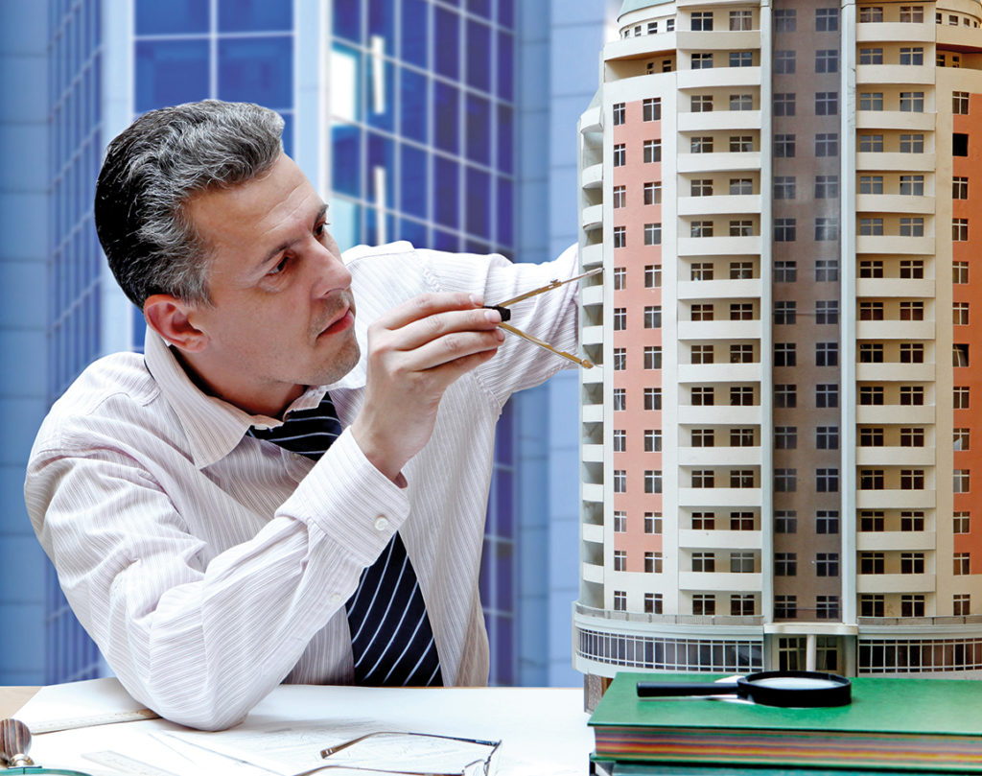
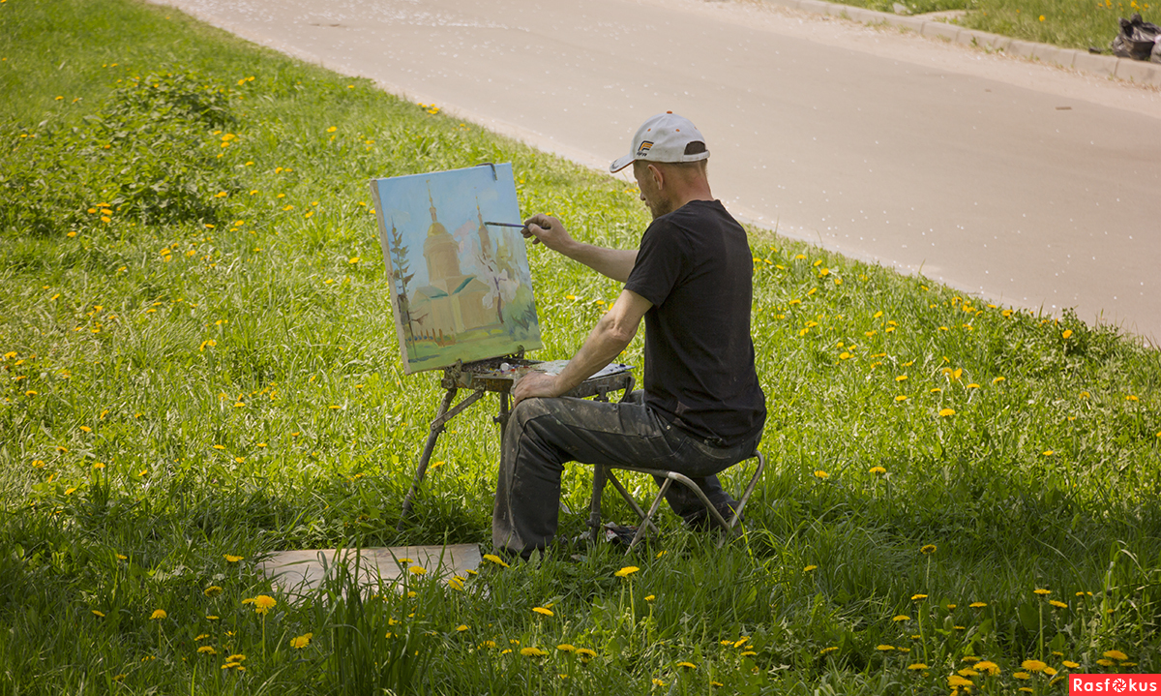
What does each person do for living?
He is an architect.
He is an artist.

Slide 6


What are they?
He is a doctor.
She is a teacher.

Slide 7
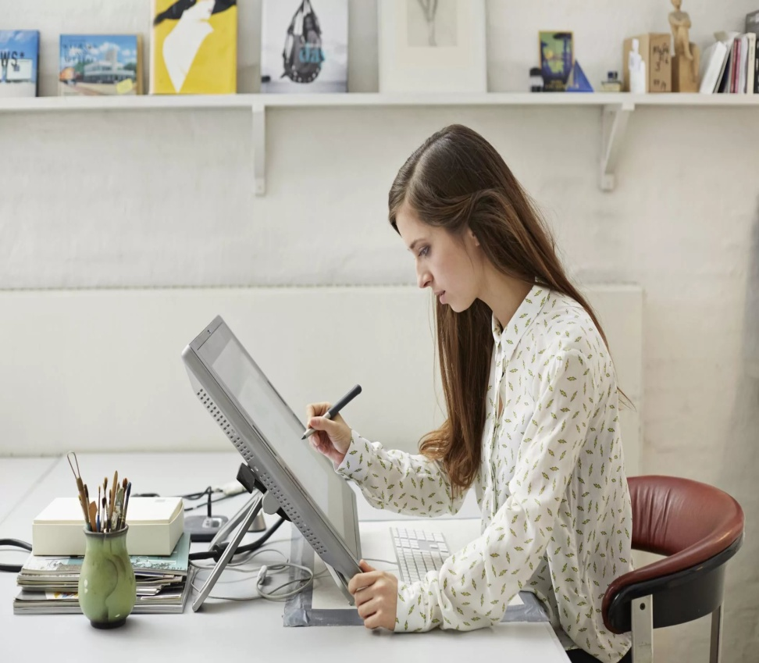
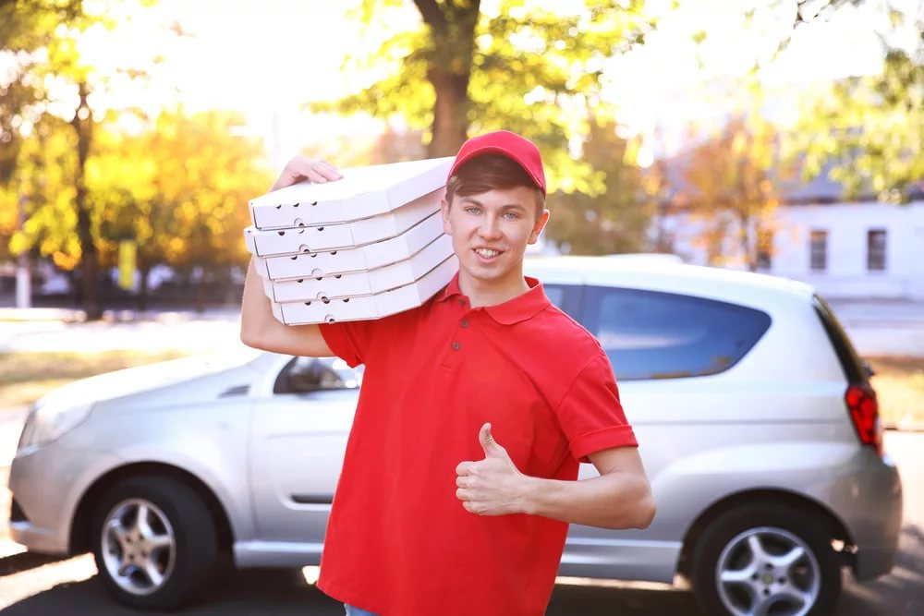
What are they?
She is a graphic designer.
He is a pizza delivery boy.

Slide 8
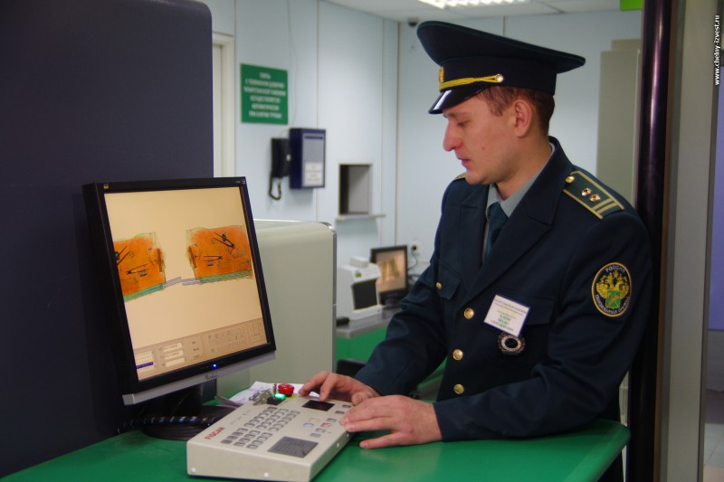
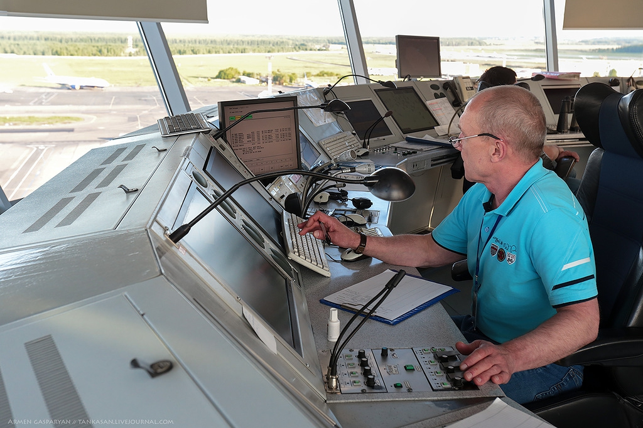
What are they?
He’s a customs officer.
He’s an air traffic controller.

Slide 9
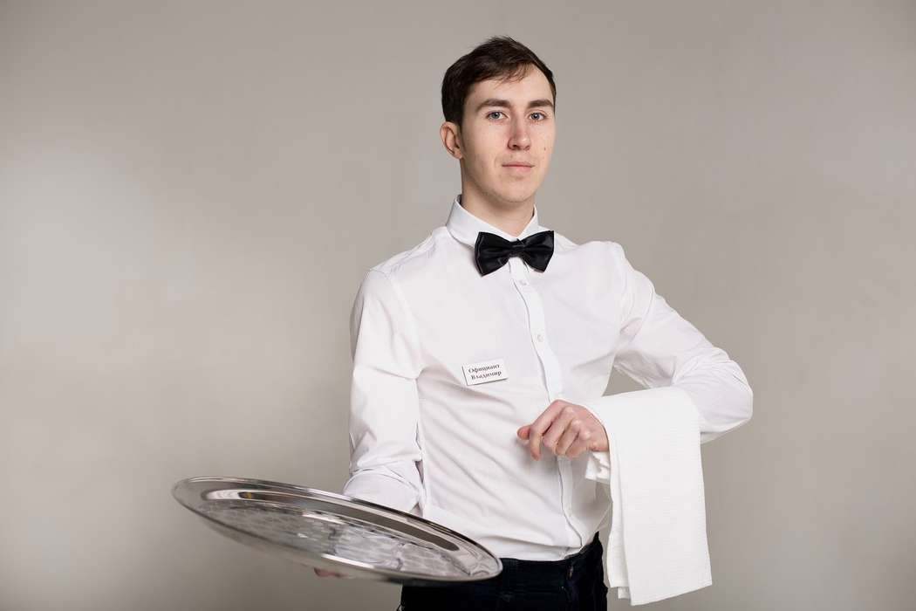

What are they?
He’s a waiter.
She’s an operator.

Slide 10
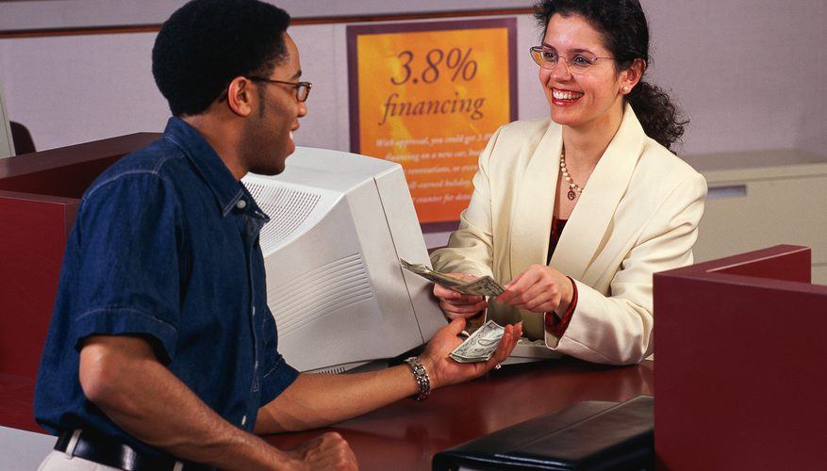
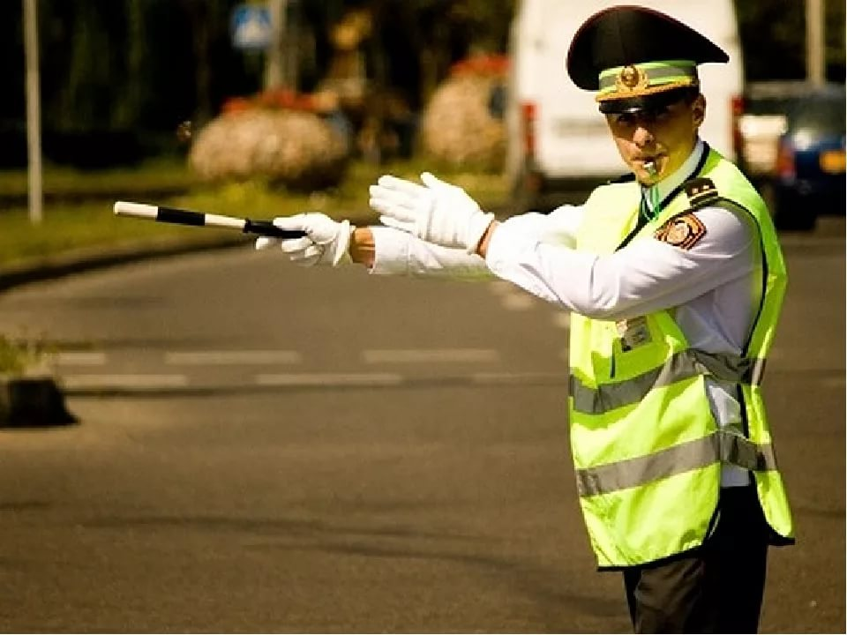
What are they?
She’s a bank teller.
He’s a traffic warden.

Slide 11


What are they?
He’s a computer programmer.
She’s an accountant.

Slide 12
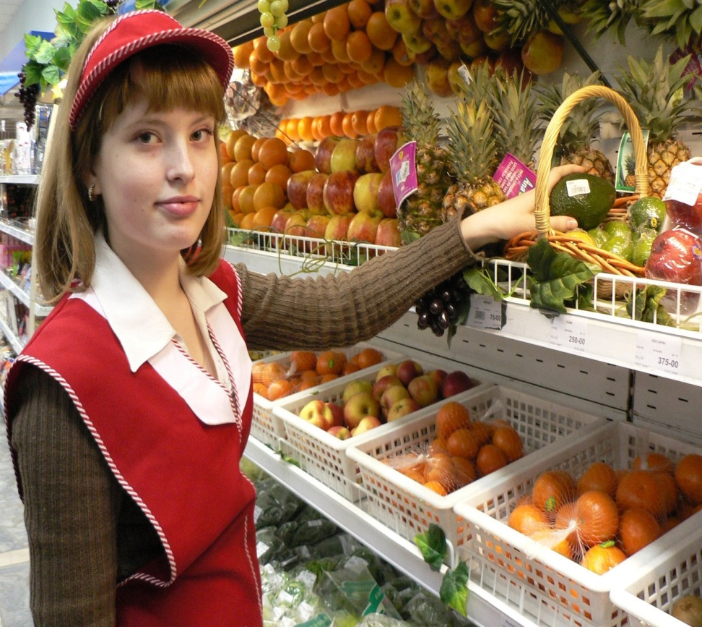
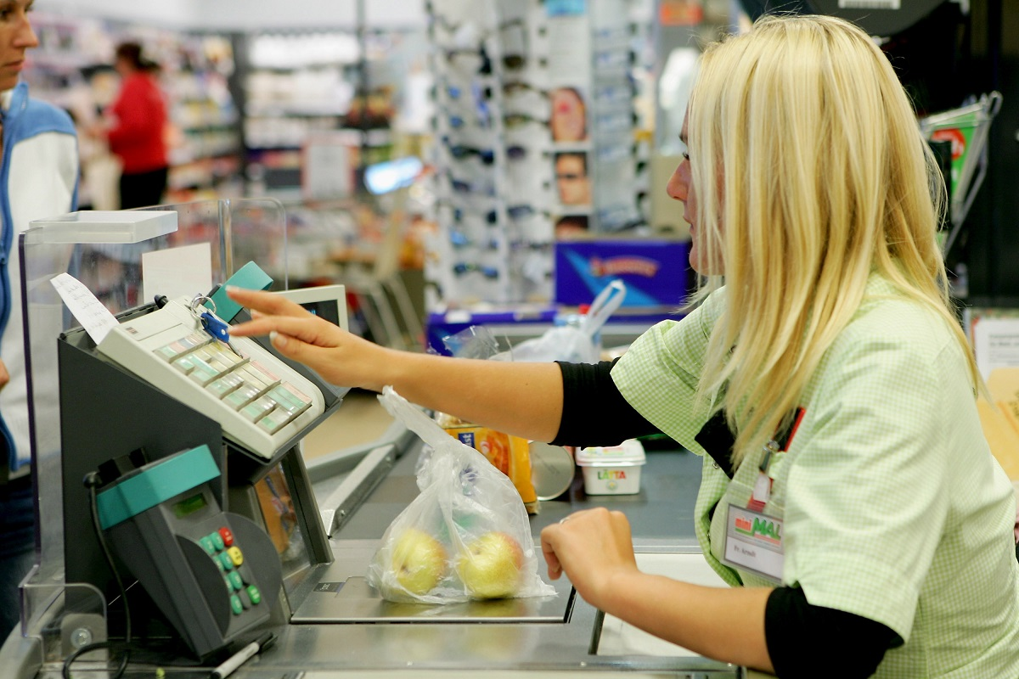
What are they?
She’s a sales assistant.
She’s a cashier.

Slide 13
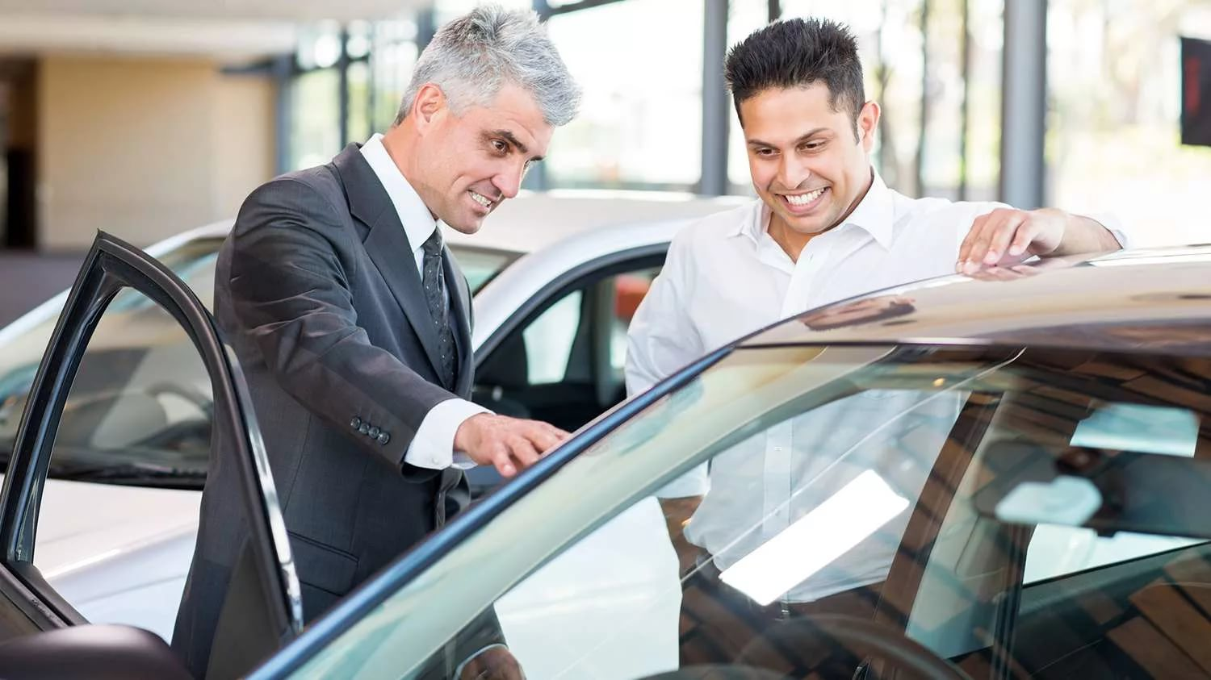

What are they?
He’s a car salesman.
She’s a vet.

Slide 14
What field of science should a person study to become a (an) …?
customs officer
accountant
mechanic
vet
doctor/nurse
teacher
lawyer
geologist
Fields of Science
Natural Science
Social Science
Applied Science
He/she should study … to become a/an …

Slide 15
Answer the questions and ask your friend the same
What is your mother?
What is you father?
What is your elder brother/sister?
What are your favourite subjects?
What do you want to be?

Slide 16
Translate the words (work in pairs)
человек, работающий на себя
freelancer -
desk job -
uniform -
full-time, part-time –
overtime -
shift -
salary -
deadline -
pay-rise -
работа в офисе
форма
полный/неполный рабочий день
переработка
смена
зарплата
срок исполнения
повышение оплаты

Slide 17
Ex.2 p.44
Listen and fill in the missing words
freelancer
desk
uniform
full-time, part-time
overtime
shift
salary
deadline
pay-rise

Slide 18
Exchange your exercise books and check the answers
1.
2.
3.
4.
5.
6.
7.
8.
9.
10.
desk
pay rise
full-time
deadlines
overtime
shift
part-time
uniform
salary
freelancer

Slide 19
Guess the profession
My brother has a full-time job. He often works overtime. He has to wear a uniform. My brother likes his job because he helps people to be healthy.
a doctor

Slide 20

Guess the profession
Ann has a desk job. She has to wear a uniform. She often works the night shift. It’s tiring but she doesn’t mind because she helps people to get necessary information in trouble.
an operator

Slide 21
Guess the profession
His father has a full-time job. He has to wear a uniform at work. He works day and night shifts. His job is very difficult and dangerous. He helps people and cars on the road.
a traffic warden

Slide 22
Guess the profession
Jack has a part-time job in summer. He works from 4 to 8 every day. He has to wear a uniform. His salary is not high but it helps him to earn pocket money. He delivers food to people’s houses.
a pizza delivery boy

Slide 23
Tell about your parents’ jobs
My … has a full-time (part-time,…) job as a…
He/she has to (doesn’t have to) wear a uniform at work.
He/she works from … to …
My … often works day/night shifts.
His/her salary is high/low.
He/she likes (doesn’t like) his job because it’s… (interesting, useful, difficult, tiring, dull, …)

Slide 24
Read and translate the questions
What’s the pay like?
Is it part-time?
What exactly does the job involve?
How long has she been working there?
What does your mum do for a living?
How does she like her job?

Slide 25

Complete the dialogue with questions
(ex. 3 p. 44)
Which questions don’t match?

Slide 26
Listen and check
1.
2.
3.
4.
- E What does your mum do for a living?
- B Is it part-time?
- C What exactly does the job involve?
- A What’s the pay?

Slide 27

Read the dialogue aloud

Slide 28

Listen and complete the missing information
(one minute test)

Slide 29

The Windmill Bakery is looking for a part-time shop assistant!
Are you:
over 1) … years old?
enthusiastic and 2)…
able to work flexible 3) … ? Join us!
Your duties will include
4) … customers
taking 5) …
No previous experience required-full training given.
Pay: 6)
16
well-organized?
hours
serving
payments
5,50 an hour
For more information call 02073108821

Slide 30
Your homework
Ex. 8 p. 45

